Slide 1
Subsetting, missing values and dates in R

Slide 2
From assignment to selection
Remembering vectors such as
X <- c(1,2,3,4)
How do we access some of X?
E.g. if we only want the 3rd element?
ANSWER: subsetting!

Slide 3
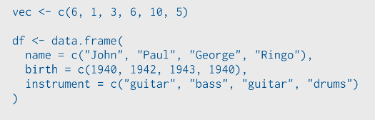
This is an example from Rstudio team
Run the following code in your head:

Slide 4
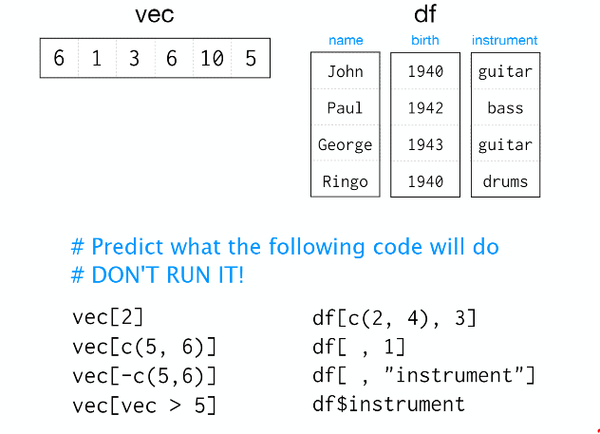

Slide 5
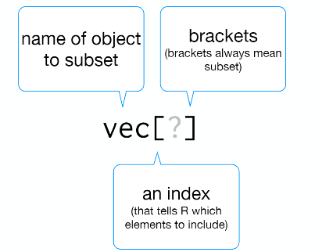
Subset notation

Slide 6
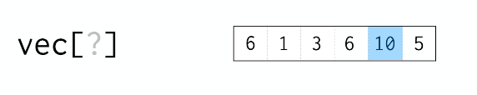
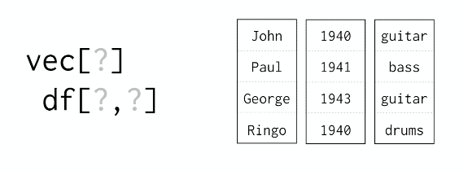
Each dimension needs it own index

Slide 7
Four ways to subset in R
Integers
Blank spaces
Names
Logical vectors (i.e. TRUE/FALSE)

Slide 8
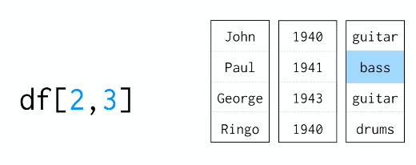
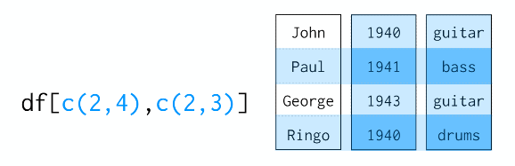
Integers
Just like ij notation from linear algebra
Can pass more than on index

Slide 9


Special cases
Colons
These give a range from i to j is i:j
Useful for creating vectors and repeating outputs
Zero
Returns nothing so empty object
Negative integer
Returns everything EXCEPT the index specified

Slide 10
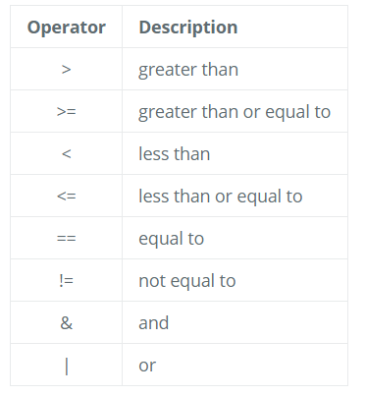
Using logical operators
We can also use indices with logical operators. Logical operators include greater than (>), less than (<), and equal to (==). A full list of logical operators in R is displayed below:

Slide 11

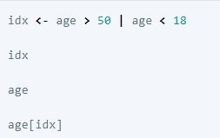
If we want to know if each element in our vector is, say greater than 50, we can write
vec > 50
Which would return
We can extend this to multiple logical conditions such as

Slide 12
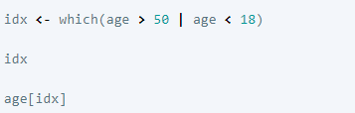
Indexing with logical operators using the which() function
While logical expressions will return a vector of TRUE and FALSE values of the same length, we could use the which() function to output the indices where the values are TRUE. Indexing with either method generates the same results, and personal preference determines which method you choose to use. For example:

